Slide 1
DAIDS Protocol Registration
Protocol Registration Policy and Manual Training 2019
John Hojnowski
DAIDS Regulatory Support Center (RSC)
Protocol Registration Office
Notes:
Hello,
My name is John Hojnowski and I am with the DAIDS Regulatory Support Center Protocol Registration Office. I want to thank everyone for attending today and welcome you to the 2019 DAIDS Protocol Registration Policy and Manual training .
A recorded version of this training will be become available once the webinar sessions are completed.

Slide 2
Objectives
Today’s Objectives:
Provide an overview of the changes to the 2019 DAIDS
Protocol Registration Manual and Protocol Registration Policy.
Provide details as to new submission requirements
Discuss ways to avoid delays in registrations
Identify some important resources
Provide methods to ask questions
Notes:
There have been many updates since the last revision of the Protocol Registration manual which was in 2015. The 2019 updates include updates due to changes/new requirements to regulations and updates to enable DAIDS to ensure sponsor oversight.
Today I hope to accomplish the following:
Provide an understanding of the changes DAIDS Protocol Registration Policy and Manual
Identify and highlight ways to avoid delays with submission approvals
Provide Important Resources
Provide methods to ask questions

Slide 3
Summary of Changes
Formatting changes and hyperlinks added to improve navigation of the manual.
DAIDS requirement for the submission of Protocol Signature Page (PSP) to document the commitment of the Investigator of Record (IOR) to conduct the trial in compliance with regulations/Laws and ensure compliance with ICH E6 GCP 4.5.1 and 5.6.3.
DAIDS requirement to submit the Clinical Trial Application (CTA) Form/documentation that identifies the study sponsor.
DAIDS requirement to submit translation certificate (or translation documentation) confirming a true and accurate translation of documents from local language into English language.
Clarification regarding staff that must be listed on the Form FDA 1572 and/or DAIDS IOR Forms in compliance with U.S. regulations and ICH E6 standards.
Notes:
<Provide overview of changes defined on the slide>

Slide 4
Summary of Changes
Change in the timeline to submit updated DAIDS IOR Forms and Form FDA 1572s
from 30 days to 15 days.
Clarified requirements regarding documents required to be submitted to DAIDS
from IRBs, ECs, REs, and Regulatory Authorities.
New guidance on the use of electronic signatures for protocol registration documents
Change to requirements regarding justifications for non-submission of
Regulatory Authority approvals of full version protocol Amendments and
Letter of Amendments (LOA).
Clarification of Continuing Review requirements based on the October 2018 FDA guidance, 21 CFR 56.109 and 45 CFR 46.109.
Notes:
<Provide overview of changes defined on the slide>
Emphasize that the signature guidance on the applied to Protocol Registration materials required to be submitted to the Protocol Registration office.

Slide 5
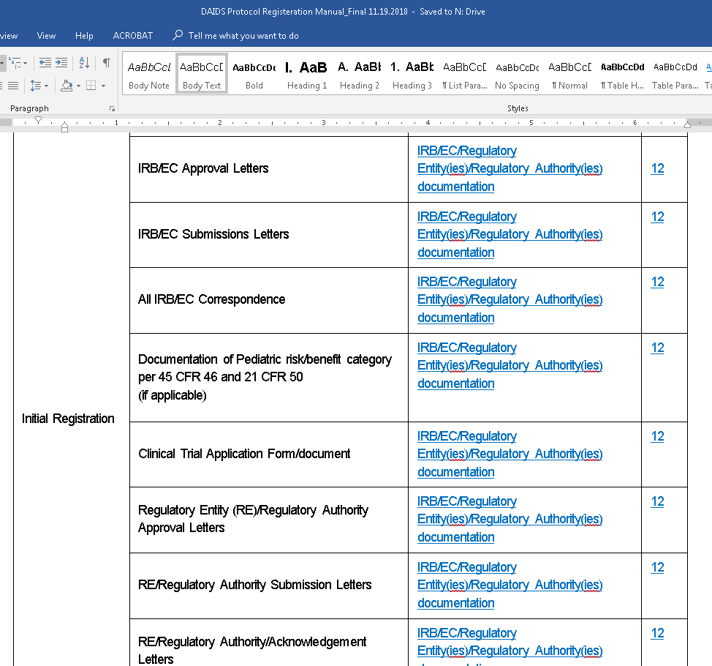
Navigating the Manual
Tables
Hyperlinks
Notes:
The first change I want to discuss is the change to the formatting of the manual. Over the years, the feedback received from users and stakeholders was to make the manual more user friendly. It has been reorganized and tables added that provide the user shorter and easier ways of finding details about what is required for specific submissions as well as the requirements for specific documents.
Lets take a quick look at the manual. <Demo the manual tables and hyperlinks>

Slide 6
Protocol Signature Page (PSP)
Effective May 2017,
submission of a protocol signature page is required for all Initials, Amendment and LOA registrations as well as whenever there is a change of Investigator of Record.
Requirements
  Protocol Title
  DAIDS Protocol Number
  DAIDS Protocol Version
  DAIDS Protocol Version Date
  Signed and Dated
Notes:
The next change is probably already familiar to most of you as it was effective as of May 7, 2017. The requirement to submit a Protocol Signature page has now been incorporated into the PR manual .
The PSP must contain the DAIDS Protocol Title, number, version date and must be signed and dated by the Investigator of Record.

Slide 7
Protocol Signature Page (PSP)
Must contain the following statement:
“I will conduct the study in accordance with the provisions of this protocol and all applicable protocol-related documents. I agree to conduct this study in compliance with United States (US) Health and Human Service regulations (45 CFR 46); applicable U.S. Food and Drug Administration regulations; standards of the International Conference on Harmonization Guideline for Good Clinical Practice (E6); Institutional Review Board/Ethics Committee determinations; all applicable
in-country, state, and local laws and regulations; and other applicable requirements (e.g., US National Institutes of Health, Division of AIDS) and institutional policies.”
Notes:
In addition, the PSP must contain the PSP statement shown here. The statement is listed in the manual and provided as part of the protocol. so in most cases, the IoR just needs to sign and date. Then it just needs to be submitted as part of all Initial, Amendment, and LOA registrations as well as anytime there is a change to the IoR.
We stated in the beginning that we wanted to discuss ways to avoid delays in registration. Incorrect or missing PSPs is one of the areas where there are many requests for corrections or provision of the form. Understanding that this is required and that the template language should not be altered will prevent delays. Sites can add if there is a required statement language but the template statement should not be changed.

Slide 8
Clinical Trial Applications
DAIDS requires that a copy of the CTA submitted to the competent National Regulatory Authority(ies) be submitted to the DAIDS RSC to verify the accuracy of the application/submission prior to sites being allowed to complete the initial protocol registration process for a protocol.
Clinical Trial Applications (CTA): An Investigational New Drug Application
for any Product filed with the FDA pursuant to Title 21 of the Code of Federal Regulations, Part 312 ("IND") or the submission to a competent Regulatory Authority within the EU of a request for an authorization concerning a clinical trial, as envisaged in Article 9, paragraph 2, of Directive 2001/20/EC, or any comparable filing made with a Regulatory Authority in another country or territory other than the U.S. or the EU.
Notes:
The next change may also be familiar to at least any international site personnel on the call today as this was implemented August 1, 2018. Submission of the in-Country Clinical Trial Application is required for all International Sites. The requirement only applies to International sites as DAIDS submits the IND as applicable for US sites.
While most of you already know this, I first want to define exactly what a Clinical Trial Application or CTA is. The full definition from the manual is on the screen and please feel free to read it either here or in the PR manual but essentially, a Clinical Trials Application (CTA) is the application/submission to the competent National Regulatory Authority(ies) for authorization to conduct a clinical trial in a specific country.
A copy of the Clinical Trial Application submitted to the National Regulatory Authority or Authorities must be submitted prior to a site being approved to participate in a trial.

Slide 9
Clinical Trial Applications (Document Requirements)
Requirements
Protocol Title
DAIDS Protocol Number
DAIDS Protocol Version
DAIDS Protocol Version Date
Identifies the Correct Sponsor
Identifies Eligible Sites
Complete and Legible
Notes:
The CTA will be reviewed to be sure it identifies the correct protocol, protocol version, the correct sponsor, its applicability to the site or sites registering to the protocol as well as for legibility and completeness.
If any of the above protocol and/or site information is not included or incorrect, the In-Country Sponsor Representative must provide a memo/letter or other documentation that allows DAIDS (or an inspector) to link the application/submission information to the correct protocol in order to verify the accuracy of the sponsor listed on application/submission and the correct study protocol.

Slide 10
Clinical Trial Applications (Submission)
Follow directions in the Clinical Trial Application Guidance located
on the DAIDS RSC Site
Submit early/avoid delays
Update if additional sites are added
Include identifiers if submitting by email
Complete the CTA checklist:
https://rsc.niaid.nih.gov/clinical-research-sites/protocol-registration-forms
Submit the CTA checklist and Clinical Trials application/ submission as PDF documents to the DAIDSRSC at ClinicalTrialApplication@tech-res.com.
Notes:
Detailed submission instructions are available in the Clinical Trial Application Guidance found on the DAIDS RSC site and reference d in the manual.
DAIDS understands that applications are sometimes submitted by a lead site, Clinical Trial Unit or IN-COUNTRY SPONSOR REPRESENTATIVE as opposed to individually by each site.
If an individual CRS is not responsible for submitting the CTA, the In-Country Sponsor Representative which created the application/submission must provide the application/submission to the DAIDS RSC or must provide the application to the CRS for submission to the DAIDS RSC.
In addition, to prevent delays, the CTA can be and is recommended to be submitted in advance of the Initial registration. This will prevent delays if not available when the registrations are submitted.
An updated CTA may also be required in the event that sites are added. This may also be submitted as soon as available.
Submitting in advance will allow the PRO to apply the document to all applicable sites and prevent any delays from having to request from each individual site.

Slide 11
Translation Requirements
Document Requirements
  Form FDA 1572, DAIDS IoR Forms, CVs, PSPs and Medical Licenses must be provided in English.
  Documentation to and from IRB/EC, Other Regulatory Entities/Authorities, IBC documentation, Clinical Trial Applications
  Informed Consents must be provided in all languages in which the CRS will conduct informed consent.
Submission Requirement
  Translation Certificate
  Translation Confirmation Document (TCD)
Notes:
The next change that we want to discuss regards translation requirements.
The types of documents that require translation has not changed much with the exception that Clinical Trial Applications have been added to the list of documents that require translation.
The bigger change is that now in addition to the Translation Confirmation Document completed by the IoR, sites must submit a translation certificate or its equivalent from the actual translator .
A translation certificate is basically signed and dated documentation by the translator/translators attesting that the translation is a true and accurate interpretation of the local language document.

Slide 12
Form FDA 1572/DAIDS IOR Form Updates
Section 6:
Names of Sub-Investigators
  All site staff that have a direct and significant contribution to the data.
    Performing Study Evaluations
    Conducting Informed Consent
    CRS Leader
    Submits SAE/EAEs
    Provide Prescriptions
When is an updated form required?
  Within 15 days of any major change
What are considered major changes?
  Change of Investigator
  Change of Sub-Investigator
  New Locations
  New Laboratory
  Addition/change of IRB/IEC/RE/RA
Notes:
Another change to make note of is regarding information identified on the 1572 or DAIDS IoR Form. While the manual has always required that all staff with a direct and significant contribution to the data be included as sub-investigators, the manual was revised to add a few more examples and to clarify what is expected.
Any staff that perform evaluations, conduct consent, submit safety information and provide prescriptions must be listed as a sub-investigator. This is in addition to the CRS leader at the site unless the CRS leader is also the IoR.
Another change regarding updated 1572s and IoR forms is the timeline for submission of revised forms. The updated form must be supplied to the Protocol Registration Office within 15 days of any major change. Some examples of major changes include any change of investigator, sub-investigator, clinical location, any lab change or change of any IRB/EC or other regulatory body.

Slide 13

IRBs, ECs, REs, and
Regulatory Authority Documentation
Approval Letters,
Submission Letters,
and Correspondence
Complete Protocol Title or Short Title
DAIDS-ES and/or Network Protocol ID
DAIDS Protocol Version Number and/or Date
Final Approval Letters
Pediatric Risk Assessment
Notes:
While the requirement to submit Approval letters, Submission letters and correspondence between the site and the IRB/IECs has been in place for many years, the requirement also now applies for all regulatory entities including any international Regulatory Authorities, Investigational Biosafety Committees or any local approving bodies.
Essentially, all communication regarding approval of the protocol at the CRS is required to be submitted including the submission letters, any correspondence and the final approval letters are required for all Regulatory entities identified on the 1572 of DAIDS IoR Form.

Slide 14
IRBs, ECs, REs, and
Regulatory Authority Documentation
What if an entity does not require submission or provide approval of subsequent submissions (Amendments, LOAs, Site Revised ICFs)?
  Memo from the IoR explaining that the submission to the entity is not required or that approval is not given
  AND
  A letter from the entity stating the same or the SOP/Guidance/Regulation or procedure that states the same.
Notes:
As many of you will know, DAIDS Protocol Registration has required justification either by use of comments or a memo that explains if documentation from an approving body is not required. This is still required however in addition, a memo from the entity themselves or the actual SOP/Guidance/Regulation or procedure that states the requirement (that their approval is not required /or approval is not given) is required or it can delay registration if the justification provided does not meet this requirement.

Slide 15
IRBs, ECs, REs, and
Regulatory Authority Documentation
Documentation of Pediatric Risk/Benefit Category
Per the DAIDS Policy for Enrolling Children (including Adolescents) in NIAID (DAIDS)-supported and/or sponsored Human Subject Clinical Research, for research studies including children or adolescents, DAIDS requires documentation of the IRB/EC designation of the pediatric risk/benefit category per the U. S. Federal regulations, 45 CFR 46, 404-407 and 21 CFR 50.51-54 and IRB /EC approval for involvement of children based on the determination specified by that category. This requirement applies to the initial and continuing/annual reviews of research protocols and to any subsequent reviews of full version protocol amendments and LOAs involving potential study risks or benefits. The documentation may be in the IRB/EC approval letter(s) or in other official correspondence from the IRB/EC to the site Investigator.
NOTE: Failure to submit documentation of the IRB/EC designation of the pediatric risk/benefit category or documentation that the CRS will not enroll children or adolescents at the time of registration submission to the DAIDS PRO will result in delays in protocol registration.
Notes:
Another area that can often result in delays is omission of documentation from IRBs or Ethics Committee regarding the IRB/ECs assessment of the Risk/Benefit Category for Pediatric Trials.
You can read the slide if you like however this is taken directly from page 28 of the Protocol Registration Manual. Per the manual, designation of the Pediatric Risk Benefit Category, as defined per U.S. Federal regulations 45 CFR part 46.404 through 407 must be completed by the IRB/EC(s) and must be submitted for each Initial, Amendment, and Letter of Amendment registration as well as for each Continuing Review submission.
This information must be included on the approval letter or ancillary documentation prior to the submissions being completed and omission will result in delays and additional submission requirements.

Slide 16
Designation of the Pediatric Risk/Benefit Category
45 CFR 46.406 and 46.407
If risk category as indicted on the IRB/EC approval letter for the submission is 45 CFR 46.407,
sites will receive request notification from DAIDS PRO to CONFIRM IRB’s/EC’s RISK CATEGORY DESIGNATION. The DAIDS PRO review process will be stopped until the site confirms the designation.
If the designation is an error, sites will need to provide corrected documentation.
If the IRB/EC confirms their decision of the 46.407 risk/benefit category selection, the CRS Principal Investigator (PI), Study Investigator of Record (IoR), or designee should refer to Appendix 1 of the DAIDS Policy for Enrolling Children (including Adolescents) in Clinical Research: Protocol Document Requirements as this risk/benefit category requires a special level of DHHS review beyond that provided by the IRB/EC. Sites can also refer to the DAIDS Policy for Enrolling Children (including Adolescents) in Clinical Research: Clinical Research Site Requirements and to the May 26, 2005 Guidance, “Children as Research Subjects and the HHS “407” Process.” The DAIDS PRO review of a CRS’s registration submission will be stopped pending a determination from the Secretary, HHS or his/her designee.
Notes:
A memo from DAIDS was distributed to sites on Friday April 19 regarding required documentation for Pediatric Risk/Benefit Category 45 CFR 46.406 and 46.407. Starting May 1, 2019, when an IRB/EC determines the pediatric risk/benefit category is 45 CFR 46.406 and CFR 46.407 for any research study, additional action and documentation will be required by DAIDS. CRSs must provide additional documentation as indicated on the this slide:
Discuss bullets

Slide 17
Designation of the Pediatric Risk/Benefit Category
45 CFR 46.406 and 46.407
For Pediatric Risk Category 45 CFR 46.406, a CRS must have established written procedures that ensure adequate provisions are in place for:
  Soliciting parents’ or guardians’ permission, as required in 45 CFR 46.408 (i.e. permission is to be obtained from both parents unless: (1) One parent is deceased, unknown, incompetent, or not reasonably available; or (2) One parent has legal responsibility for the care and custody of the child).
  Soliciting documenting assent, when the IRB/EC requires that assent be obtained.
  Enrolling wards (e.g., orphans) with the appropriate documentation that: (1) recognizes the status of the individual child as a ward; (2) ensures communication of that status to the responsible IRB/EC; and (3) confirms the IRB/EC appointment of an advocate for the child/ward, in addition to any other individual acting as guardian or in loco parentis.
Refer to the DAIDS Policy DWD-POL-CL-007.02 DAIDS Policy for Enrolling Children (including Adolescents) in Clinical Research: Clinical Research Site Requirements.
A CRS’s written procedures to address the requirements of 45 CFR 46.406 should be kept in the CRS’s regulatory files for verification by monitors.
Notes:
For risk category 46.406, a site must have established written procedure that includes the requirements as indicated on the slide. Monitors will be verifying that a site has established appropriate written procedures for enrollment of children in clinical research.

Slide 18

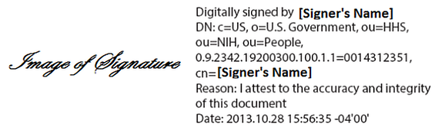
Signature Requirements (General)
Handwritten Signatures
If utilizing a handwritten signature, the date associated with the signature must also be handwritten.
Electronic Signatures
If an electronic signature is used, the typed date must match the electronic date stamp.
Notes:
The PR manual has been updated to allow either handwritten or electronic signatures and now references a guidance as to what can be accepted.
Some general requirements to consider are that for hand-written signatures, If the date is handwritten, the signature must also be handwritten. Documents with a hand-written signature and typed date will not be accepted and if an electronic signature is used, the typed date must match the electronic date stamp.

Slide 19
Electronic Signatures
An Electronic Signature is a computer data compilation of any symbol or series of symbols executed, adopted, or authorized by an individual to be the legally binding equivalent of the individual’s handwritten signature (21 CFR 11.3(b)(7)).
Part 11 compliant
Adobe Acrobat Self-Sign Plug can be utilized for 1572s
International Sites - Compliant with any requirements applicable within country
Notes:
An Electronic Signature is a computer data compilation of any symbol or series of symbols executed, adopted, or authorized by an individual to be the legally binding equivalent of the individual’s handwritten signature.
Adobe Acrobat Self-Sign plug-in can be utilized to insert your signature on fillable FDA Forms (e.g., Form FDA 1572). Alternatively, for U.S. Sites, any part 11 compliant method to utilize an electronic signature will be accepted. For international Sites, some countries may have defined additional requirements which should also be considered when applying electronic signatures. Use of methods to electronically sign documents that do not minimally meet part 11 compliance requirements will not be accepted.

Slide 20
Electronic Signatures
The printed name of the signer;
The date and time when the signature was executed; and
The meaning (such as review, approval, responsibility, or authorship) associated with
the signature.
Notes:
Here we have an example of a compliant electronic signature.
Electronic signatures should contain the printed name of the signer, the date and time when the signature was applied and the meaning of the signature. For the purposes of Form FDA 1572/DAIDS IoR Forms, the placement of the signature in the signature section provides the meaning of the signature in agreeing to the commitments identified on the form.
Please see the Signature guidance document referenced in the manual and located on the DAIDS RSC site for additional examples and guidance on signature requirements.

Slide 21
Continuing Review Requirements
Per the October 2018 FDA Guidance on FDA-Regulated Clinical Investigations (studies under an IND), IRB/ECs must continue to comply with current FDA requirements for IRB/ECs continuing review at 21 CFR 56.109(f), including for clinical investigations that are subject to both HHS and FDA jurisdiction.
IRB/ECs are required to conduct continuing review of research at intervals appropriate to the degree of risk, but not less than once per year (21 CFR 56.109(f)).
Notes:
The manual has been updated to provide some clarity on Continuing Review requirements. The requirements could vary depending on a number of conditions and whether the study is an IND or non-IND study.
For IND studies, Per the FDA guidance issued in 2018, for protocols that are under HHS and FDA jurisdiction, continuing Review continues to be required at least once a year as required by 21 CFR 56.109(f).
DAIDS follows the FDA Regulations for IND studies

Slide 22
Continuing Review Requirements
For studies that are NOT conducted under an IND, DHHS regulations, 45 CFR 46.109(e) require that all DHHS supported research undergo continuing IRB/EC review at intervals appropriate to the degree of risk, but NOT LESS than once per year except as described in §46.109(f).
Notes:
For non-IND studies, DHHS regulation 45 CFR.109 also requires that Continuing IRB/EC Review occur at least once annually but under the revised Common Rule, there are provisions that allow for no annual continuing review as described in 45 CFR.109(f). The details of the provisions are summarized in the manual in addition to 45CFR.109 (f).
However, for Non-IND Studies, sites should always follow the local/in-country and most stringent of the regulations at the study/site Jurisdiction.

Slide 23
Continuing Review Requirements
How does this apply to DAIDS Protocols?
Non-IND studies:
If an IRB makes a determination that annual reviews will not be required, documentation from the IRB that references the specific regulation exempting the protocol from Continuing Review. Is required.
IND studies:
IRB/IEC Continuing Review must be performed on an annual basis.
Notes:
So how does this affect participation and required submissions to DAIDS Protocol Registration.?
For IND studies, there are no exemptions from Continuing Review so sites must continue to obtain and submit CR documentation to the DAIDS Protocol Registration Office for all IND studies.
For non-IND studies, it is the IRBs responsibility to determine if they will not conduct CRs on a per protocol basis and must provide documentation of the exemption which must include reference to the specific regulations that allows the exemption. Once this is submitted to the PRO, the requirement of the continuing review submission will be noted so that sites will not be requested to submit annual reviews.

Slide 24
Common Submission Requests
Missing/Incorrect ICF(s)
Missing/Incorrect IRB submission letters/Sent to IRB Date
Missing/Incorrect Protocol Signature Page (PSP)
Missing/Incorrect TCD
Missing/Incorrect CTA(s)
Notes:
We have covered the changes to the manual and would now like to briefly cover some common reasons that submissions may be delayed due to the need to request clarification or additional documentation.
On the screen, we have listed the most common Non IC related issues with submissions as seen over the last 2 years. We will briefly go over each and some methods to prevent any of the common issues.

Slide 25
Missing ICFs
Initial Registration
Site Specific Informed Consent(s)
- all applicable languages.
All ICFs required by the protocol are required to be submitted or justification for the omission is required.
Amendment Registrations
Site Specific ICF
- all applicable languages.
All previously approved ICFs
must be submitted or justification provided for their omission must be provided. Any new ICFs added within the protocol ICFs must be submitted as an Additional ICF type or justification provided for their omission must be provided.
Notes:
The most common issue is failure to submit all ICFs required by the protocol or previously approved in a prior registration.
For initial registrations, all ICFs that are defined in the protocol are required to be submitted to the PRO for review and approval prior to being utilized at the site. The PRO does understand that for some protocols, not all sites participate in all parts of the study and that some ICFs may not be required at all sites however the PRO does not have any way of determining which sites are performing which parts of the trial and it is the CRS responsibility to inform us when creating the submission. When submitting, if your CRS will not be participating is part of a trial and the ICF is not required, please enter notes in the comment section and the PRO will not need to request justification which will speed up the registration process.
This is even more common for Amendment registrations. ICFs are added or sometime removed from protocols as part of the amendment. PR requirements state that all previously approved ICFs must be submitted or justification provided as to why not. We do understand that some ICFs may no longer be part of the trial however different organizations may or may not keep the ICFs active for a variety of reasons. As the PRO cannot determine if the ICF has been inactivated at individual sites, it is the CRS responsibility to notify the PRO at the time of submission. This will again prevent the PRO from having to request information as to what ICF’s are in use for the current version registration and prevent any delays with registration.

Slide 26
Missing/Incorrect IRB/IEC/RE Documentation
Requirement
Complete protocol title or short title for any DAIDS approved version of the protocol is listed (i.e. current or previous version, short title, IC title) | IRB/EC Submission
DAIDS-ES and/or Network Protocol ID | IRB/EC Approval Letters
DAIDS Protocol Version Number from the final version of the protocol approved by DAIDS and/or the final version date of the protocol document approved by DAIDS | All correspondence with the IRB/EC relating to the trial approval
Final approval letter provided | Documentation of Pediatric risk/benefit category per 45 CFR 46 & 21 CFR 50 – if applicable
Pediatric Risk Assessment included in the IRB approval Letter. | Regulatory Entity Submission Letters
For LOAs and Amendments - The date that the amended protocol documents were submitted to the local IRB is provided in the IRB approval letter or memo/CRS note, that predates the approval is provided | Regulatory Entity Approval Letters
Approval letters from all applicable IRB/EC/REs as listed on the Form FDA 1572 or DAIDS IoR Form are included or justification for their omission was provided. | All correspondence with the Regulatory Entity relating to the trial approval
 | Regulatory Entity Clinical Trial Application (See Clinical Trial Application below)
Notes:
The next most common issue is missing IRB/EC or other regulatory required documentation. This is actually more relevant now than under the previous manual as more documents are required. The submission and approval letters along with any applicable correspondence must be submitted for all entities on the 1572 or DAIDS IoR form and all entities for which approval is provided must listed on the 1572 or IoR form or this could lead to delays when registering.
In addition, documents from IRBs, ECs or other Regulatory entities need to be linkable to the correct protocol and version. The DAIDS title, ES or Network ID, and the protocol version number must be present. For pediatric trials, the Pediatric Risk assessment must also be listed.

Slide 27
Missing/Incorrect PSP, TCD or CTA
Clinical Trial Applications (CTA) | Complete protocol title or short title for any DAIDS approved version of the protocol is listed (i.e. current or previous version, short title, IC title)
 | DAIDS-ES and/or Network Protocol ID
 | DAIDS Protocol Version Number
 | Name of the sponsor or sponsors of the trial
 | Identifies the DAIDS site(s) for which the application is applicable
Protocol Signature Page (PSP) | Submitted for Initial, Amendment or LOA and Change of IoR
 | Contains the following statement verbatim: I will conduct the study in accordance with the provisions of this protocol and all applicable protocol-related documents. I agree to conduct this study in compliance with United States (US) Health and Human Service regulations (45 CFR 46); applicable U.S. Food and Drug Administration regulations; standards of the International Conference on Harmonization Guideline for Good Clinical Practice (E6); Institutional Review Board/Ethics Committee determinations; all applicable in-country, state, and local laws and regulations; and other applicable requirements (e.g., US National Institutes of Health, Division of AIDS) and institutional policies.
 | Signed by the IoR that is currently identified as the IoR for the specific study site.
 | Lists the full DAIDS Protocol Title
 | Lists the DAIDS Protocol Number
 | Lists the correct DAIDS Protocol Version (including LOA version when applicable.
 | Lists the correct DAIDS Protocol LOA Version if applicable.
 | Lists the correct DAIDS Protocol Version Date
Notes:
I have combined the last three most common non ICF issues onto one slide. In many cases, these documents are not included with the initial submission or are incomplete when received. Remember that a TCD is required anytime that there is a translation as is the Translation Certificate.
In addition, a PSP is required for each version and for each IoR at the site and a Clinical Trial Application is required for all Initial Registrations or whenever additional sites are added.

Slide 28
Informed Consent Requirements
Costs to You/Payment
DAIDS Policy – Compensation
Compensation/Treatment of Injury
Confidentiality/Inspection of Records
Notes:
The other primary reason for delays in registrations would be Informed Consent requirements with the most common issues having to do with cost, compensation, and treatment of injury as well as with issues with confidentiality language and Inspection of Records.

Slide 29
Informed Consent Requirements
DAIDS Policy DWD-POL-CL-02.00
  Compensation for Study Related Injury - The ICF must state that the U.S. National Institutes of Health (NIH) does not have a mechanism to provide direct compensation for research related injury. (If a mechanism to compensate for study related injury is available, this must be explained in the ICF.)
45 CFR 46.116 (OHRP)
  For research involving more than minimal risk, an explanation as to whether any compensation is available if injury occurs [and] where further information may be obtained
  Any additional costs to the subject that may result from participation in the research
Notes:
Three of the most common issues involve compensation, costs and research related injuries. All ICFs must contain the NIH compensation statement listed above which states’ “<read statement> or similar statement with the same meaning.
In addition based on 45 CFR part 46, the ICF must explain if there is any compensation and must identify who is responsible for any costs incurred from participating in the trial. These can result in a disapproval or at least require correction and can delay the start of the trial at a given site.

Slide 30
Informed Consent Requirements (continued)
45 CFR 46.116
  A statement describing the extent, if any, to which confidentiality of records identifying the subject will be maintained
21 CFR 50.25
  A statement describing the extent, if any, to which confidentiality of records identifying the subject will be maintained and that notes the possibility that the Food and Drug Administration may inspect the records.
Notes:
The other primary area where ICF issues are identified are Confidentiality and Inspection of Records. The CFRs above require that the participant be informed as to what degree of confidentiality will be maintained and that it be identified that the FDA may review the records.
As DAIDS has many international trials that may be subject to review of other national regulatory bodies, a statement to that extent is also required.

Slide 31

Resources
Contacts and Important Links
Notes:
The last topic I would like to cover today are the resources available to assist you with Protocol Registration requirements and submissions including important contact information and links.

Slide 32

Resources - Contacts
The Protocol Registration Office
PRO correspondence E-mail:
protocol@tech-res.com
Phone: 1-301-897-1707
DAIDS CRMS Support
E-mail:
CRMSSupport@niaid.nih.gov
Phone: 1-240-778-2517
Notes:
For this last topic, The first resource that I want to identify to you is the DAIDS RSC Protocol Registration Office itself. The DAIDS RSC PRO staff is on hand to answer any questions regarding DAIDS Protocol Registration requirements. Communication is often the key to success and we are available by phone or email to assist you.
Also shown here is the contact information for DAIDS ES support. Should you require any assistance with accessing the DPRS or require any other technical support when using the DPRS please contact DAIDS ES support.
The DAIDS RSC PRO strives to provide accurate and timely support for sites so that the important work that you do can take place. Please do not hesitate to contact us if there are ever any questions.

Slide 33
Important Links
Protocol Registration Manual and Policy
  Link to the 2019 DAIDS Protocol Registration Manual
    https://www.niaid.nih.gov/sites/default/files/prmanual.pdf
  Link to the 2019 DAIDS Protocol Registration Policy
    https://www.niaid.nih.gov/sites/default/files/protocolregpolicy.pdf
DAIDS RSC Website
  http://rsc.tech-res.com
Notes:
The next valuable resource that I want to provide are some important links to documents and websites.
The first links shown here are for the Protocol Registration Manual and the DAIDS policy. An understanding of the manual and policy will greatly enhance your understanding of DAIDS requirements.
These links as well as several others are available on the DAIDS RSC site which is the third link identified here.
<Go to RSC Link>

Slide 34
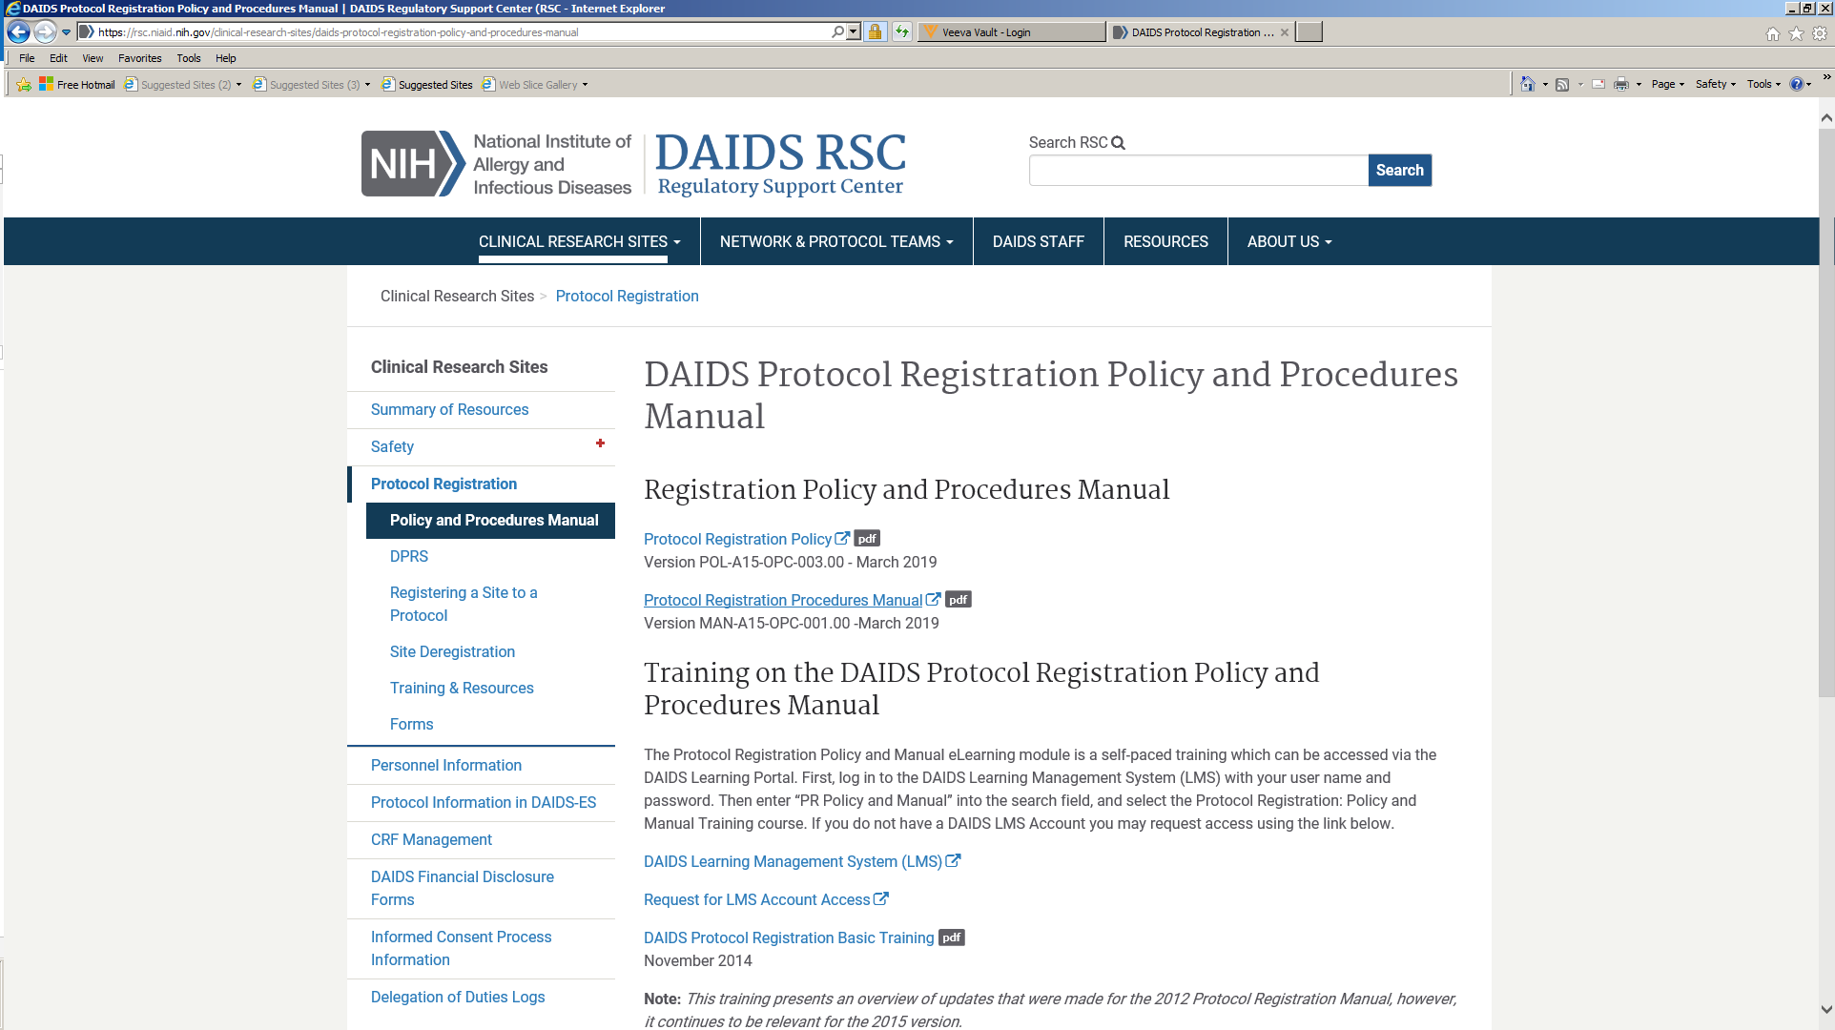
Important Links
Notes:
The DAIDS RSC site provides a single source for all of your protocol registrations needs including trainings, guidance’s, important forms as well as Frequently asked questions. Show here is the DAIDS RSC home page which in addition to protocol registration information you can find information for a host of other topics including Safety and Human Subject Protection.
<Select Protocol Registration>

Slide 35
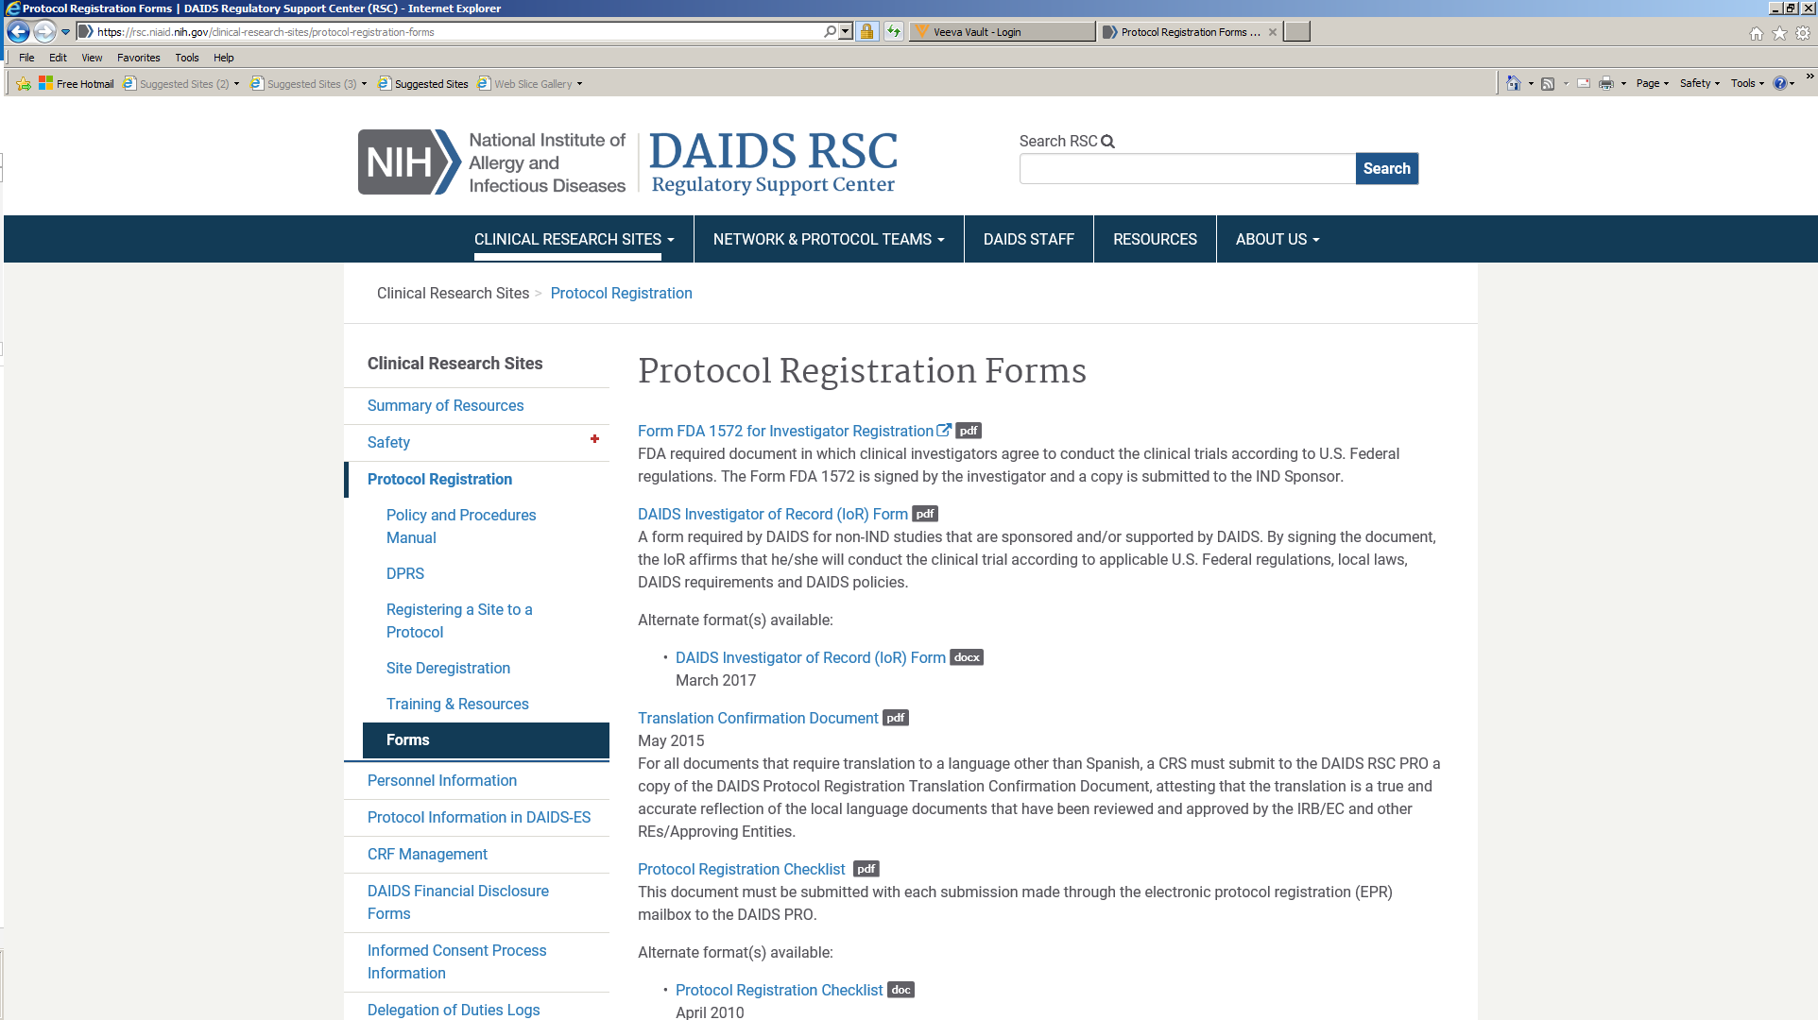
Important Links
Notes:
The Protocol Registration page has several important pieces of information. Shown here are various guidance's and important links to forms such as the 1572 and Translation Confirmation Document we discussed earlier.
You can also view some of the more commonly asked questions by selecting the Frequently Asked Questions tab.

Slide 36
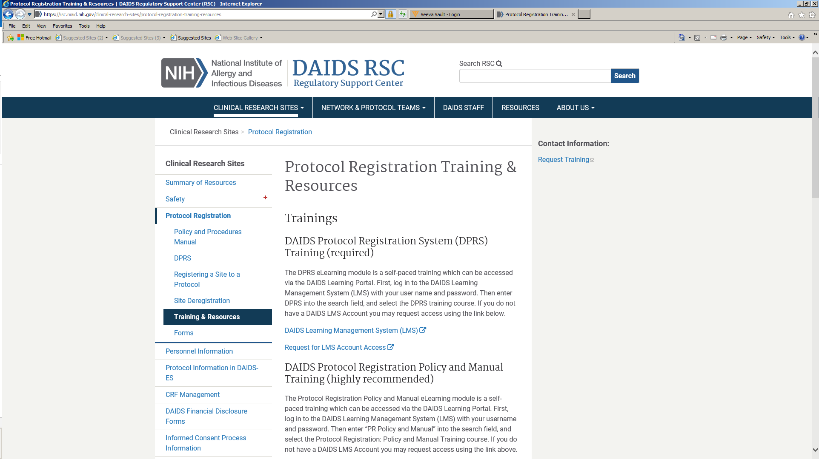
Important Links
Notes:
In addition, all of the training resources are available here including the link to the DAIDS Learning portal and the required DPRS training program. Please use the DAIDS RSC site for all of the resources needed to assist you with Protocol Registration.

Slide 37

Conclusion
Notes:
This concludes our discussion for today. I would now like to open up the meeting to any questions.
<Answer any questions>
If there are no other questions, I would like to thank you all for your attendance. As always, if any assistance is needed, please do not hesitate to contact the PRO so that we may support your efforts to conduct these important clinical trials.
Thank you

